Slide 1
SMART INDIA HACKATHON 2018
TEAM NAME : Vibe
TEAM ID : 20249
TEAM LEADER : Saakshi Srivastava
TEAM MEMBERS : Siddhau Jain
Sree Aslesh Penisetty
Ankit Kumar Singh
Pamireddy Sucharitha
Dhriti Kumari

Slide 2
Automated Parcel Sorting Using OCR & PTL Solution

Slide 3
Current scenario in India Post
According to the India Post survey, India has the largest postal network in the world with over 1,54,882 Post offices of which 89% of offices are in rural areas and there is no standard operating procedure for sorting of letters, postal cards, small parcels, voluminous parcels etc.
Currently, India post has a modernized automatic mail processing system, which can sort 20,000 letters or small parcels per hour but still in rural areas, sorting of letters are done manually.
These automatic mail processing facilities are provided in the main hubs of Delhi and Kolkata only according to the survey of 2012.
But barcodes are scanned and are sorted further, manually for larger or voluminous parcels like books, electronic items etc.

Slide 4
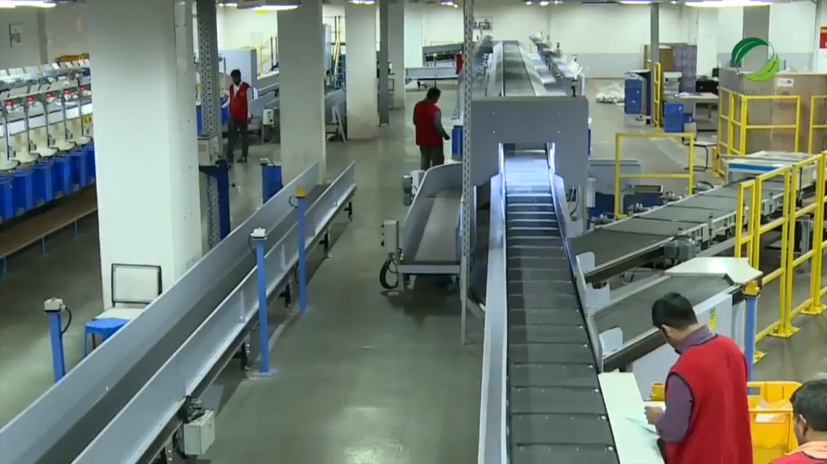
A glimpse of how parcel sorting is done manually in India Post
Inference from the video :
Using method of manual sorting
Definite need of skilled labour
Possibility of human error

Slide 5
Problem Statement
The existing parcel sorting happens manually either on floor area or on conveyor belt.
The entire parcel sorting does not have any Standard Operating Procedure which brings down the sorting efficiency.
At the primary sort level, articles are sorted into groups of range of pin codes to be sorted further
( secondary sort ) and bagged for destination
hubs.
But currently, secondary sort requires a skilled
labour to find the correct destination bag.

Slide 6
How sorted parcels are checked ?
There are three levels to this :
Initial Sorting is done by a sorting assistant
Then it is verified by a senior sorting assistant
And for a final check it goes to the Head sorting assistant
Even after going through such a rigorous process of checking for the correct sort of the parcel there is a small and even considerate possibility of human error.

Slide 7
How many parcels could be wrongly sorted with a chance of 0.1% chance of human error ?
According to some workers in India Post parcel hubs,
sorters sort 800 letters in a shift of 8 hours.
Considering, at least 0.1% of error by 1 sorter, then, number of parcels , getting sorted wrong = | 800*0.1= .8
Considering, at least 50 sorters in a postal hub, then, Total number of parcels, getting sorted parcels= | .8*50= 40 parcels (out of 50*800= 40,000 parcels)

Slide 8
Estimate of the solution
In india we have around one and half lakh post

Slide 9
Considering such a possibility of error we have two ways to choose from which would improve the sorting efficiency 1. Semi-manual sorting using PTL solution and unskilled labor. 2. Complete automation of the sorting mechanism.
We will go into the details, benefits and systematic evaluation of both the mechanisms

Slide 10
Automated sorting mechanism

Slide 11
Goals and Objectives of automated solution
To eliminate the human operated mechanism for parcel sorting system.
To improve the delivery time.
To reduce manual error.
To maximize productivity and efficiency in minimum cost.

Slide 12
Role of automation in sorting mechanism
Primary Sorting : In this phase of the sorting the OCR (Optical Character Recognition) is used to read the barcode and get data about the parcel from the pre existing database.
Secondary sorting : In this the automation is done using a box based sorting mechanism. There are series of flaps which actuate based on where the parcel is supposed to go.

Slide 13
Enter sorting process
Barcode Scanner
Parcel
with barcode
Fetch data
from database

Slide 14
Description of the secondary sorting mechanism
The alignment of the stacks of boxes are as shown.
This is a mechanism which is expandable to any number of zones which we would like to sort the boxes into.
There are flaps on each zone box which act as selectors as to where the parcel has to go into.
This mechanism minimizes the space constrain of the current sorting mechanism used.
Zone 1
Zone2
Zone 3
Zone 4
Zone 5
Zone 6

Slide 15
Benefits of Automated Parcel Sorting
Removes manual labour
Minimizes human error

Slide 16
Semi – Manual Parcel Sorting using PTL solution

Slide 17
Goals and Objectives of semi-manual sorting

Slide 18
Description of secondary sorting mechanism
The secondary sorting mechanism is implemented here with the help of PTL solution which can be emphasized as “Put To Light ” Solution.
Put To Light solution is an effective way to reduce cost of implementation and running the mechanism .
It works on the basis that when the barcode is read , it checks for the destination and based on the destination it will glow a light based on which the bag has to be placed in.

Slide 19
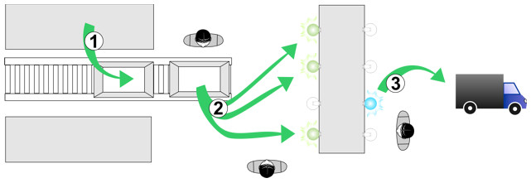
What is PTL ?
The PTL solution is usually employed for order assortment, product consolidation, tracking, traceability, kitting, product assembly, replenishment, packaging, validation, and slotting, among others.
When products arrive at the assortment zones, their barcode is scanned, thus illuminating the corresponding displays and providing an exact instruction of where should the product be placed.
Operators immediately confirm the operation. An inventory control is provided, which allows identifying the order status; all of this in real time. Additionally, this control identifies the time needed for completion regarding the productivity currently handled by the system.

Slide 20
Benefits of Semi-Manual Sorting mechanism
Employment opportunity for unskilled labor in the village areas
Give the rural citizens of India a chance at a secure living
Cost effective for the government
Time efficient as to reduces the time required for sorting
Low maintenance cost
Reduces percentage of human error

